Slide 1
Digital Twins: Simulation and Optimization
An industry-oriented research initiative
12th June 2025
Slide 1

Slide 2
Executive Summary
Professional organizations require decision support systems
What-If analysis: How will my product/system behave if an event happens?
If-What analysis: If my system behaves this way, what is my best option?
Many vendors offer digital twins
But some offerings are platforms and frameworks, not full solutions.
Taylor-made customized full solutions are costly to built and maintain.
A full solution – a complete digital twin simulation – is required at economic scale.
We propose an AI system to build and maintain the complete simulated digital twin
Objective #1: Technically prove that our AI-built twin is competent and maintainable
Objective #2: Commercially prove that out AI-built twin is economically viable for us and for the industry.

Slide 3
Background
Slide 1

Slide 4
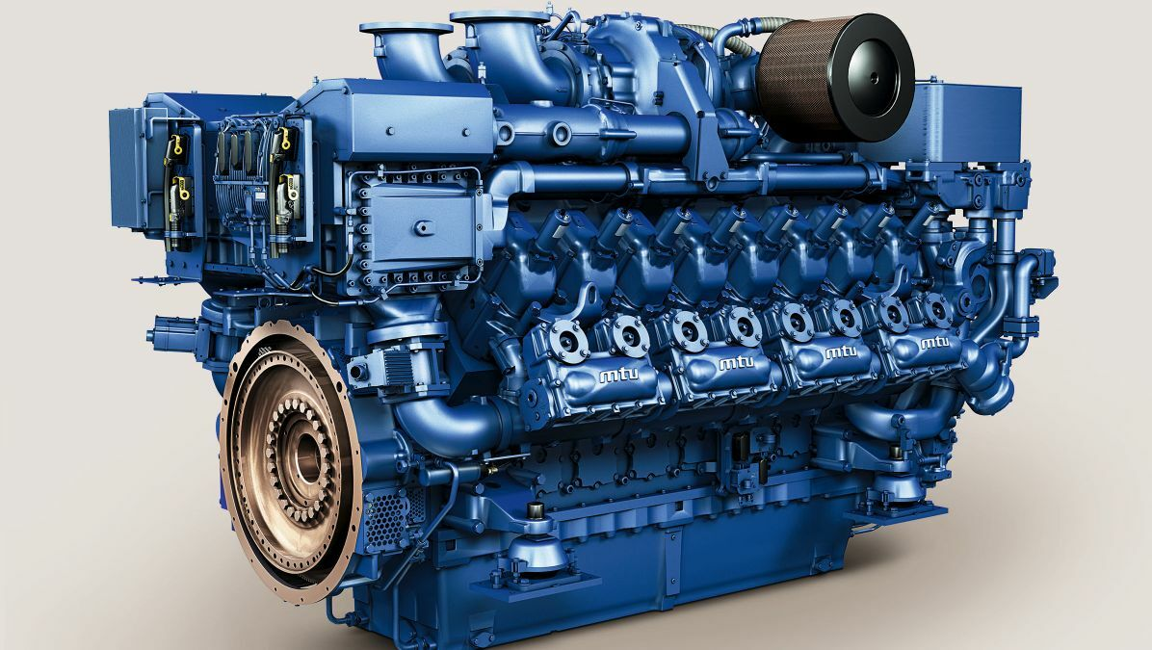

What do we mean by “Digital Twins”?
Industries use simulations extensively
Software simulations mimic real-world products/processes.
Experiments and ideas can be tried out safely and cheaply on simulations.
A digital twin is a ready-to-use simulation.
Actual Decision
Optimization
Real-world product
Simulation
The real challenge is the massive cost and effort to initially build and later maintain the digital twin.

Slide 5




How did we come up with this?
Does not exist
Require
Validate
- Reliable
- Up-to-date
- Auto-Adapt
- Flexible to answer questions
Customer Organizations
New Algorithms
Decision Support Systems
Digital Twin
Simulation
Understand current process
Develop a Digital Twin
Validate and confirm the twin
Actual Optimization improvement

Slide 6
Why don’t organizations make more digital twins?
A twin is costly
Typically, digital twins are made manually by teams of SMEs
A digital twin needs to be maintained regularly to be relevant.
Commercial OTS offerings are mostly platforms and frameworks, not full solutions.
So then, what do companies do?
Build digital twins only for extremely critical products.
Build digital twins only for some portions.
Not maintain beyond minimal critical period.

Slide 7
So, where is the opportunity?
Digital twins need not always be a hand-crafted SME-developed high-priced custom product
An AI-based, re-trainable, flexible off-the-shelf digital twin can serve most purposes.
We make a factory of digital twins.
We provide simulation as a service.
Will such an AI-based digital twin work everywhere?
No, we do not challenge niche areas at all.
We will not even try FEA, CFD, Flame propagation, Soft-body dynamics, multi-body simulations.
Then where will such an AI-based digital twin work?
This works for multi-component simulations and network models including full-factory models.

Slide 8

Is this really possible?
Our Digital twins is not a hand-crafted SME-developed high-priced custom product
Who? | What? | When? | Data Provided | SME Inputs | Model Creation | Validation of Digital Twin
Finnish Gold mine | Ore handling and extraction | 2023 | ✔ | ✔ | ✔
Fortum | Kaukolämpö District heating network | 2024 | ✔ | ✔ | ✔
Danfoss | Electro-mechanical Propulsion system | 2025 | ✔ | !
Wärtsilä | Power plant | 2025 | ! | ✔
Our work is the ongoing result of industry-supported research for other academic optimization projects where we needed digital twins before the main optimization.

Slide 9
Techno-Commercial Details
Slide 1

Slide 10
Problem Definition
What-If Analysis
If-What Analysis
Automate the creation of Digital Twins
If something changes, how will my systems react?
In case one energy plant stops, how will the district heating kaukolämpö network be affected?
In case one motor burns out, how will a Wärtsilä power plant be affected?
Knowing what I know now, how best can I plan for future?
Where should Fortum place new storage tanks for the best RoI?
Should the next Wärtsilä power plant designs include extra motors?
Can digital twin be made without permanent in-house teams of programmers and experts?
A “core” digital twin is re-trainable for use across organizations and segments
The digital twin adapts to changed circumstances

Slide 11
Our Technical Solution
SME Inputs
System Model
Expert Basis Functions
Simulation Engine
Optimizer If-What
Network Builder
Core: Deep Reinforcement learning
Customer Data
Novel algorithms: Patent-able IP
Network builder
Expert Basis functions
RL Core

Slide 12
Commercial Viability
Currently, we are a research-based academic initiative
We are building Simulation-as-a-Service
Eventually, our work can offer subscription-based and usage-based pricing
No Payment
Share Data
No payment
Validate model
Pay on Success
Model Purchase
Pay-per-use
Pay-per-update
Initial Agreement
Model Ready
Run Proven Model
Maintain and use
All participants are currently working on voluntary basis without any payment and without any promises of payment, financial rewards or ownership stakes. No IP rights are being created or committed for any organization.

Slide 13
Overall Market Opportunities
Global Simulation Market
Valued at $13.25 billion in 2022 (Source: Grandview Research)
CAGR 13% from 2024 to 2030 (Source: Markets and Markets)
Forecasted Market Size $31.6 billion by 2030 (Source: Statista)
Portfolio
Process optimization
Supply chain management
Predictive maintenance
Engineering Analysis
Application Operations
Industry and Market Segments
AI in simulation market
Valued at $2 billion in 2022 (Source: Deloitte Insights)
CAGR over 20% (Source: McKinsey & Co.)
Forecasted Market Size $8.6 billion by 2030
Industry Sectors
Energy & Utilities
Manufacturing
Automotive
Electronics
FMCG

Slide 14
Competitors
Our Competitors
Large IT Platform/ Infra
Niche Portfolio-specific
Experts: Custom digital twins
Other/ Assorted
MS Azure Digital Twin Platform
IBM Watson
Cognascents
ProSims
Ansys Digital Twin Solution
PTC Thingworx
Silo.AI
Reaktor
Futurice
Valohai

Slide 15
Planned Milestones
Technical Research Milestones
Prove the flexible optimizer
Auto-train to adapt to changed data
Validate integration with overall core
Validate stand-alone Industry-specific models
Correlate with RoI to ensure profitability
Quantify total optimization effort
Commercial Milestones
Quantify re-training effort
Quantify per-model customization effort
Aug – Oct 2025
Nov – Dec 2025
Jan – Mar 2026
Apr – Jun 2026
Jul – Sep 2026
Oct – Dec 2026
Start-up
Timelines

Slide 16
Commercialization Plans
Commercialization Options
Start-up
Acquisition
Direct Sale
No Payment
Share Data
No payment
Validate model
Pay on Success
Model Purchase
Pay-per-use
Pay-per-update
Initial Agreement
Model Ready
Run Proven Model
Maintain and use

Slide 17
Why will we succeed (when others cannot)?
Assurance of Convergence: Expert basis functions
Our extensive experience helps us build the right basis functions
Without these functions, model will never converge
Novel algorithm
Not exactly pure Reinforcement learning or classical Deep NN
Automated NN builder via Optimizer: Two-arm bandits
Otherwise this becomes a purely manual activity – Un-solveable bottleneck for the company.
Without these network-building optimizers, our models will be inflexible and non-adaptable.

Slide 18
Current Team
Slide 1

Slide 19
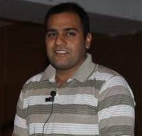

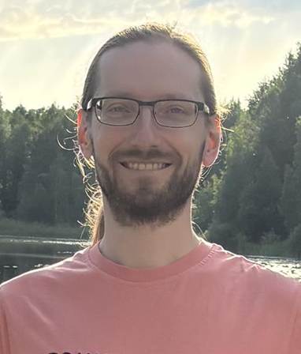
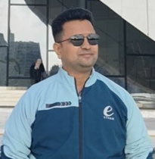

Team and skillsets
Dr Niraj Ramesh
We need this person soon!
Technical Expertise and execution lead
Simulation and Optimization
Commercialization expertise
Marketing and Financial
Deep Learning Expert
Dr Anton Akusok
Building the core digital twin factory
Dr Ganesh Soni
Industrial processes expert
Building the domain-specific interfaces
Needed
No IP rights will be committed for any organization at the current stage.

Slide 20



Potential Steering group
Person Name | Organization | Interest
Potential names being discussed | Fortum | Twin of Kaukolämpö
 | Wärtsilä | Full factory model
 | Danfoss | Model of electromechanical propulsion system
 | Pending | Research in marketing and strategy
 | Arcada UAS | Research in industrial simulation
 | University of Turku | Research in Deep learning

Slide 21
What do we need?
Slide 1

Slide 22
Our Current Open Requirement
We have sufficient technical/implementation expertise
Our team already has the mathematical, computation and subject matter knowledge
We need Managerial expertise → Market strategy expert
Build a plan and direction on what to do “commercialize”
Decide the marketing plan, the sales strategy, the price point, etc.
Build the Go-to-market strategy. Prove the commercial viability. Decide the price points
This person will help make the commercialization plan to decide marketing plans, product placement, commercial viability assessment and go-to-market strategy.

Slide 23
What will the marketing expert get?
The marketing expert gets consulting fee (payment)
This will be paid as a one-time payment upon completion at agreed rate.
This is an initiative to “test the waters” for viable research
An initiative to check whether our ideas are techno-commercially viable. If yes, we will consider research / commercialization
This initiative helps build industrial connect
Major Finnish industries are involved or have shown active interest.
This is not an IP ownership scenario
We are not a commercial company. We don’t know if/when we can be.
There are no commitments for IP rights because we cannot create an IP burden in any direction currently.
We have research grant funds available
We have research grant funds from multiple sources.
None of our industry partners currently pay us. There are no commercial payments agreed from them.
This person will be working without any promises of ownership stakes or IP rights at the current stage.

Slide 24
Other information
Slide 1

Slide 25
FAQs
Project Aims
What do we want to accomplish with the project?
How does the project aim to create a business case?
How significant effect will it cause financially in the society and in exports?
Project Teams
State the expertise of members and the dedication of the partner companies to taking this case into fruition.
Which partners have committed to the project and what concrete plans they have to take the research into business?
Generic Questions
How is the research innovative in the field of Digital Twins
Can you clearly state all the strengths and prove that the application has everything to succeed not just with the project but going forward?
What will be done, by whom, with Whom, and what will be accomplished in the end.

Slide 26
For a new customer, what do we “technically” do?
Data Collection
Industry Specific Model
Setup DRL Neural
Model Training
Identify the known input parameters.
Identify the most likely influencing variables for every sensor point.
Identify the potential basis functions to help correlate faster.
We have a 2-arm bandit → One arm defines how many layers. Another arm identifies the neurons per layer.
Train the DRL network from known data points.
Discover the most relevant intermediate “control” points.
Agree upon desired output parameters
Efficiently makes the network model based on likely graphs (inter-relations)
Proceed only upon convergence

Slide 27
Thank you
Basic Research is DONE
Generalizable as a service?
Technically and Commercially Feasible?
Validate PoC and assess RoI
Notes:
We have completed the basic research. We need funds for proof of concept tests to verify the functionality of our idea. PoCs for validation of concept. Customer surveys -- Assessing RoI for digital twin to deduce revenue realization possibilities.

